Slide 1











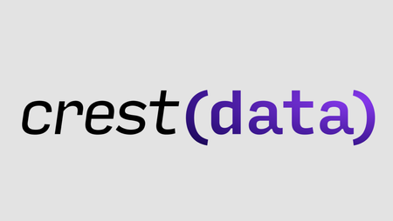
Studio Shodwe
Track-3: Intech-Smart Route
Sponsors
Title: Smart Route Optimizer
BY:
Aaryan Shah(22BCM002)
Abhinav Sinha(22BCM004)
Ansh Shah(22BCM007)
Anubhav Shah(22BCM008)
Samarth Shah(22BCM054)
Team Name: CryptoVoid

Slide 2
PROBLEM STATEMENT
This Smart Route Optimizer delivery planning solution is envisioned as an advanced home delivery solution designed to optimize grocery and essential item deliveries. The system will automatically create trips having multiple shipments and also sequence shipments to optimize the route while addressing key operational goals:
1. Maximize Vehicle Capacity Utilization: Efficiently use vehicle space to reduce the number of vehicles required for delivery.
2. Minimize the Number of Trips: Optimize the allocation of shipments to reduce overall delivery trips.
3. Minimize the Overall Distance: Trips should be created with a view to reduce the overall distance travelled by vehicles.
4. Be Aware of Trip Completion Time: Ensure trips are planned within acceptable time limits to meet delivery commitments because users have the option to choose delivery timeslot. (Can use some approximation like MST Distance)
5. Enable Automated Vehicle Type Allocation: Assign the most appropriate vehicle type based on number of shipments. Note: Priority Vehicles(3W, 4W-EV) should be used first or guaranteed use of them.

Slide 3
INTRODUCTION
Traditional delivery planning methods are often manual, leading to delays, underutilized resources, and increased operational costs.
To address these inefficiencies, Smart Route Optimizer leverages AI and machine learning to automate shipment sequencing and vehicle allocation, ensuring more efficient deliveries.
By utilizing real-time data, it optimizes route planning, minimizes travel distance, and ensures timely deliveries within designated time slots.
This intelligent solution enhances operational efficiency, reduces costs, and improves overall customer satisfaction, making last-mile delivery more effective and reliable.

Slide 4
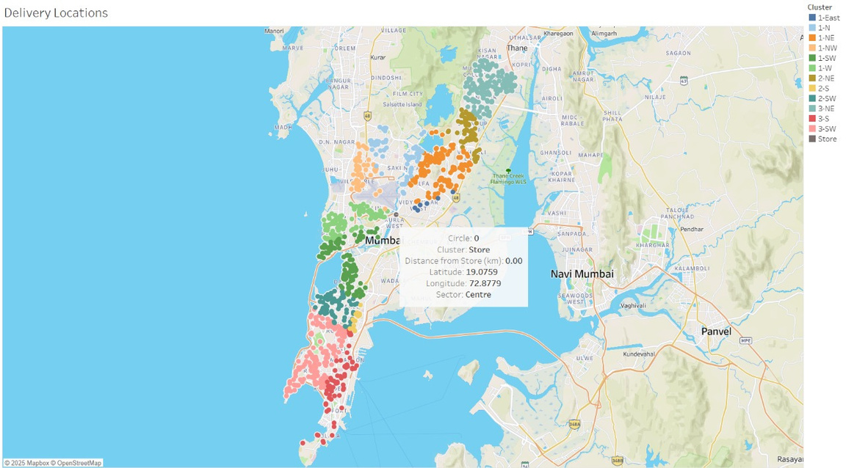
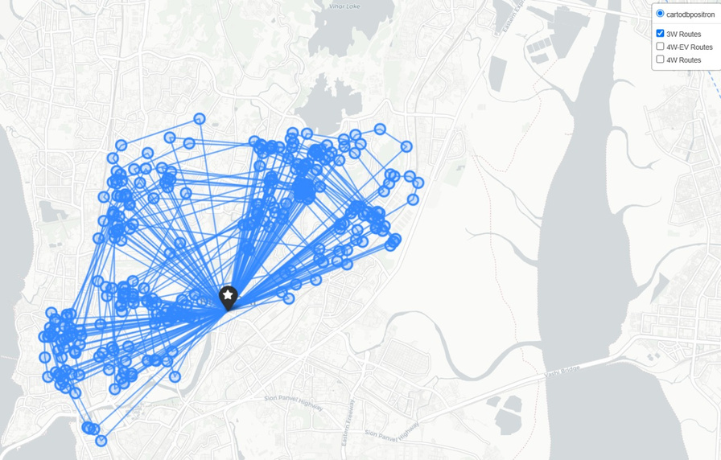
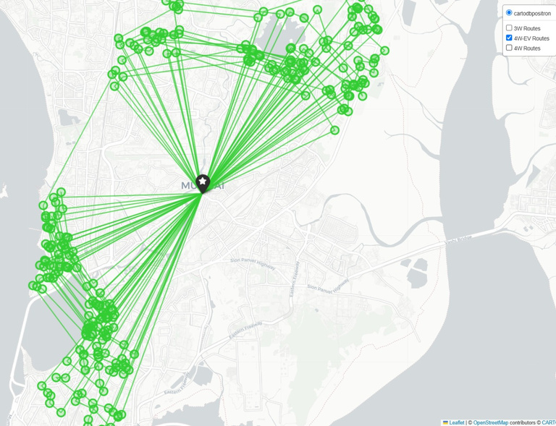
PROPOSED APPROACH
The proposed approach optimizes last-mile delivery by dynamically assigning shipments to vehicles based on capacity, maximum radius, and delivery time constraints.
Using a nearest-neighbor heuristic, shipments are grouped into efficient routes while ensuring at least 50% vehicle utilization.
Priority is given to smaller vehicles (3W, 4W-EV) before larger ones (4W) to minimize costs. Geodesic distance calculations help determine feasible assignments, and unassigned shipments are integrated into existing routes when possible. Finally, an interactive map visualizes optimized routes, improving efficiency and reducing operational overhead.

Slide 5

WHY ONE SHOULD CHOOSE THIS SOLUTION?
01
Cost-Effective: This solution is implemented using Python , making it affordable .
02
Simple and Easy to Use: The logic is straightforward, making it easy to deploy and to differentiate between vehicle types.
03
Customizable: Users can modify delivery routes and schedules as per their needs.
04
Works Offline: Since it doesn’t rely on external AI APIs, it functions without an internet connection.
05
Quick Implementation: It provides an immediate working solution for small to mid-sized businesses .

Slide 6
LIMITATIONS:
01
Lack of Real-Time Traffic Awareness
02
Multi-Timeslot Optimization Missing
03
No Adaptive Re-Routing Based on Real-Time Factors
04
No Penalty for Late or Inefficient Deliveries

Slide 7

Demo Video:

Slide 8
THANK YOU!!

